Slide 1
Analysis, Design and Implementation
Topic 7:
Design Patterns (1)
Notes:
NCC Education - Title Master

Slide 2
Introduction
  We have spent the past few lectures discussing primarily the analysis and design elements of building software.
  In this lecture, we are going to explore some of the ways we can make our implementation more effective by making use of design patterns.
  Design patterns are particular software development techniques that can be used to achieve design goals.

Slide 3
Design Patterns - 1
  As part the design process of building a piece of software, we encounter situations that we think will be difficult to write in code.
    Any time you think to yourself ‘I am not sure how this is best done’
  Design patterns are collections of objects and classes that are aimed at meeting a particular design need.
    There are many dozens of well established patterns, and we can only discuss a few of these.

Slide 4
Design Patterns - 2
  Design patterns fill the role of ‘high level design’ in object-oriented programs.
    It is often difficult to develop ‘good’ object-oriented solutions.
    Design patterns are a shorthand for particular collections of objects, arranged in a particular way.

Slide 5
Design Patterns - 3
  Design patterns are battle-tested.
    A pattern only enters into common acceptance when it has been shown to work in many situations – as such, we can be confident that it works.
  Design patterns are generalised.
    A design pattern is to object design what an algorithm is to lines of code.
    We need to write it with our specific context in mind.

Slide 6
Representing Design Patterns
  A design pattern is a collection of (usually) several different classes.
  It defines the interaction of these objects at a higher level of abstraction. The examples we see are just examples:
    You need to implement them in the context of your own systems.
  They are not solutions themselves, just the ‘shape’ of solutions.

Slide 7
Benefits of Patterns - 1
  Part of what design patterns bring to the field of software engineering is a common vocabulary for design, i.e. shorthand solutions for certain kinds of recurring programming problems.
  Design patterns are ‘best practice’, and thus allow for portability of the ‘lessons learned’ of experienced developers.
    They are an aid to learning - you get the benefit of avoiding the mistakes others have made over the years.

Slide 8
Benefits of Patterns - 2
  They fit in easily with existing modern programming techniques.
    Design patterns complement object-orientation
    They are easily expressed as UML diagrams for the most part.
  Design patterns reduce the need for future large-scale refactoring.
    They are tried and tested, and the result of successive refactoring of their own.

Slide 9
Criticisms of Patterns - 1
  Some of the patterns that are in common usage are simple workarounds for missing language features.
    Some patterns are repetitions of things supported syntactically in other languages.
  Can lead to systems that are heavily over-engineered.
    Use with care – it’s tempting to put patterns in when there is no real requirement.

Slide 10
Criticisms of Patterns - 2
  There is a saying in English: “When all you have is a hammer, every problem looks like a nail.”
    This is the tendency of people to assume that the one solution they have available is the one that is always right.
    Patterns represent good solutions to recurring problems, but they are no substitute for effective analysis.
  Counter-productive when building expertise.
    You learn more from failure than you do from success.

Slide 11
Design Patterns - 4
  Design patterns are broken down into a number of different categories.
    Structural
    Creational
    Behavioural
  The first of the patterns that we are going to look at is called the factory design pattern.
    This is a creational pattern.

Slide 12
Creational Design Patterns
  We use creational design patterns for several reasons:
    Some situations are more complex than simple instantiation can handle. Imagine for example you want to create an entirely ‘skinnable’ look and feel for an application.
    Some situations have complex consequences if objects aren’t instantiated in the right way or the right order.
    Some situations require that only one object is ever created.

Slide 13
The Factory Pattern
  The Factory Pattern is used to provide a consistent interface to setup properly configured objects.
    You pass in some configuration details…
    Out comes a properly configured object.
  At its simplest, it can be represented by a single class containing a single static method.
    More complex factories exist, dealing with more complex situations. These are all variations on the basis structure we will discuss in the lecture.

Slide 14
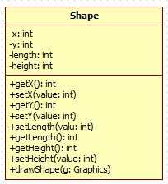
The Factory Design Pattern - 1
  Imagine a class:

Slide 15
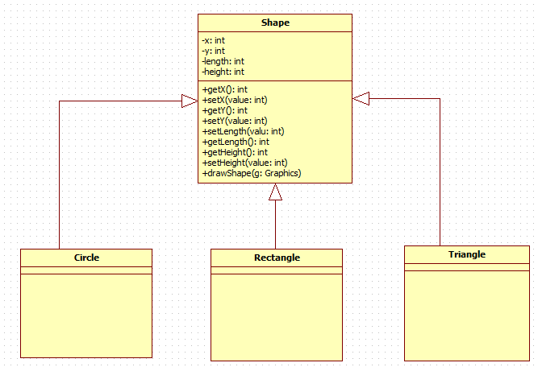
The Factory Design Pattern - 2
  Then imagine a simple class hierarchy:

Slide 16
The Factory Design Pattern - 3
  Now imagine you are creating a simple drawing package that works as follows:
    User selects a shape
    User clicks on the screen
    Application draws the shape at that location.
  This can all be hard-coded directly into an application. This suffers from scale and readability issues as the application becomes a maze of ‘if’ statements and switches.

Slide 17
The Factory Design Pattern - 4
  Instead, we can use a factory to generate specific objects, through the power of polymorphism.
    Polymorphism is key to the way a factory works.
  The system that drives a factory is that all these shapes have a common parent class. Thus, all we need is the Shape object that is represented by specific objects.
  The objects themselves manage the complexity of the drawing process.

Slide 18
The Factory Design Pattern - 5
public class ShapeFactory {
public Shape getShape (String shape, int x, int y, int len, int ht, Color col) {
Shape temp = null;
if (shape.equals ("Circle")) {
temp = new Circle (x, y, len, ht);
}
else if (shape.equals ("Rectangle")) {
temp = new Rectangle (x, y, len, ht);
}
else if (shape.equals ("Face")) {
temp = new Face (x, y, len, ht);
}
temp.setDrawingColor (col);
return temp;
}
}

Slide 19
The Factory Design Pattern - 6
  The Factory Pattern reduces hard-coded complexity. We don’t need to worry about combinatorial explosion.
  The Factory Pattern properly devolves responsibility to individual objects.
    We don’t have a draw method in our application, we have a draw method in each specific shape.
  However, the Factory Pattern by itself is limited to certain simple contexts. For more complicated situations, we need more.

Slide 20
The Abstract Factory - 1
  The next level of abstraction is the Abstract Factory.
    This is a factory for factories.
  Imagine that we have slightly more complicated situations:
    Designing an interface that allows for different themes.
    A file conversion application that must allow for different versions of different formats.
    A bank that provides different kinds of accounts for their customers.

Slide 21
The Abstract Factory - 2
  We could handle these with a factory by itself.
    But this introduces the same combinatorial problems that the factory is designed to resolve.
  A simple rule to remember is – coding combinations is usually bad design.
  Bad design causes trouble later on.
  When doing anything more substantial than simple ‘proof of concept’ applications, we should always be sure to engineer our systems properly.

Slide 22
Bad Design
public Component getComponent (String type, String theme) {
Component guiComponent;
if (theme.equals ("swing")) {
if (type.equals ("button")) {
guiComponent = new JButton ();
}
else if (type.equals ("label")) {
guiComponent = new JLabel();
}
}
else if (theme.equals ("awt")) {
if (type.equals ("button")) {
guiComponent = new Button ();
}
else if (type.equals ("label")) {
guiComponent = new Label();
}
}
return guiComponent;
}

Slide 23
Good Design - 1
  Good Design in this case involves creating one factory that creates the right kind of factory for the components:
    We have a SwingFactory and an AWTFactory.
    That factory generates the appropriate components.
  This requires a somewhat more complicated class structure.
    Each factory must inherit from a common base.
    We get the factory and then use that to create our objects.

Slide 24
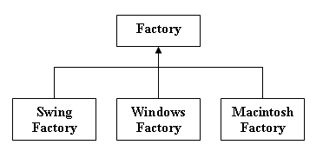
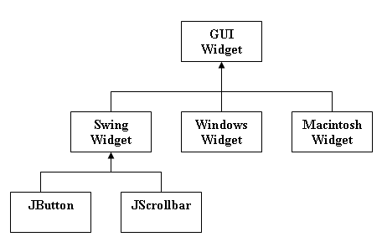
Good Design - 2

Slide 25
Abstract Factory Implementation
public class AbstractFactory {
public static Factory getFactory (string look) {
Factory temp;
if (look.equals ("windows")) {
temp = new WindowsFactory();
}
else if (look.equals ("swing")) {
temp = new SwingFactory();
}
else if (look.equals ("macintosh")) {
temp = new MacintoshFactory();
}
return temp;
}
}

Slide 26
Factory Implementation
public class SwingFactory extends Factory {
public GuiWidget getWidget (string type) {
SwingWidget temp = null;
if (type.equals ("button")) {
temp = new JButton();
}
else if (type.equals ("scrollbar")) {
temp = new JScrollbar();
}
return temp;
}
abstract class Factory {
abstract GuiWidget getWidget (String type);
}

Slide 27
The Consequence
  Entirely new suites of themes can be added to this system without risking combinatorial explosion.
  The ‘operational’ code is also much tighter and more focused.
Factory myFactory = AbstractFactory.getFactory ("swing");
GUIWidget myWidget = myFactory.getWidget ("button");

Slide 28
Using Patterns - 1
  Patterns are best decided upon in the design phase of development.
    During our analysis, we may encounter situations that require the creation of large amounts of objects.
  We use the factory and/or abstract factory when we must deal with potentially large combinations of objects that must be created and configured.
  If we see such a requirement, we make sure to place our design pattern in the appropriate part of our class diagram.

Slide 29
Using Patterns - 2
  Much of deciding when we should use patterns is based on our own pattern recognition.
    We see that a particular kind of functionality is going to be suited to a pattern of which we are aware.
  Experimenting with patterns is an important part of building that skill.
  We have to see what patterns can do, how they do it, and how they can be moulded to meet our own specific needs.

Slide 30
Conclusion
  Design patterns are an important technique for handling the implementation of complex functionality.
    They can be described as algorithms for object and class design.
  The Factory Design Pattern is used to handle the creation of objects that stem from a common base.
  Abstract factories are factories for factories.
    We choose the factory we want, and use that to generate objects.

Slide 31
Topic 7 – Design Patterns (1)
Any Questions?
Notes:
NCC Education - End Slide Master

